Slide 1
MOCKITO
ZEPHYR
GRAFANA

Slide 2
GROUP 1
VISHNU SATHYAN
ARJUN SHILLIN
AUGUSTINE JIMMY
PARVATHY MADHU
MUHAMMAD FAIZ
ARYA MOL ASOKAN

Slide 3
MOCKITO

Slide 4
Mockito is a mocking framework
It is a java based library used to create simple and basic test API’s for performing unit testing of java applications
It can also be used with other frameworks such as Junit and TestNG

Slide 5
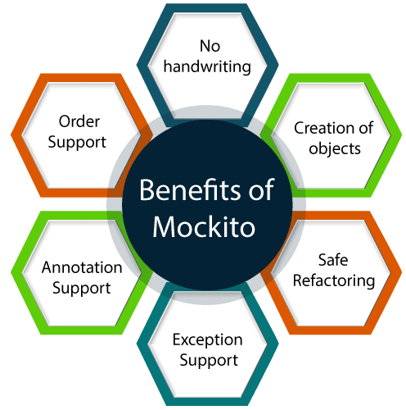

Slide 6
GRAFANA

Slide 7
Grafana is open source visualization and analytics software.
Designed by Torkel Odegaard in January 2014
It enables us to create a dashboard for collecting, processing, storing, and analyzing data from various different sources
It allows you to query, visualize, alert on, and explore your metrics, logs, and traces no matter where they are stored.
It provides you with tools to turn your time-series database (TSDB) data into insightful graphs and visualizations.nd our data, beautifully sources.

Slide 8
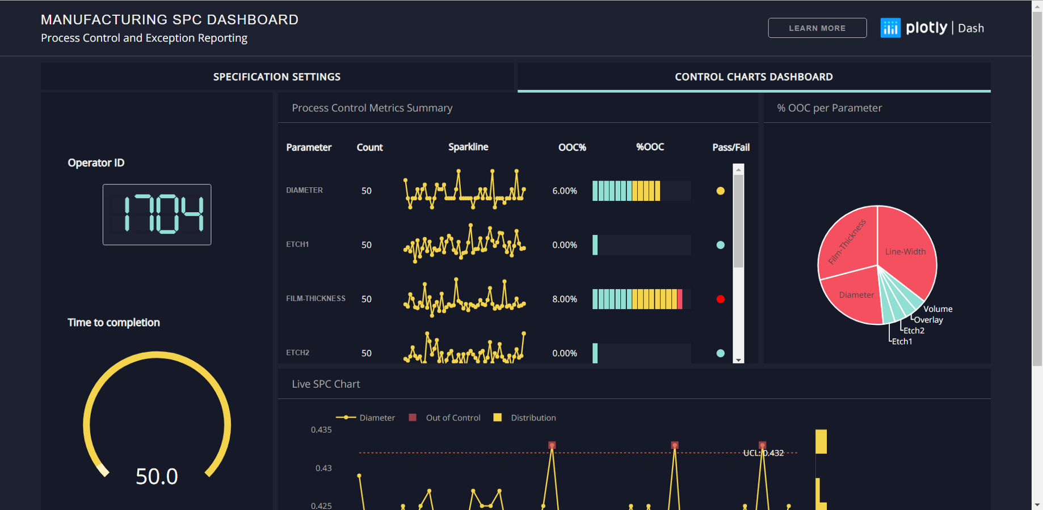
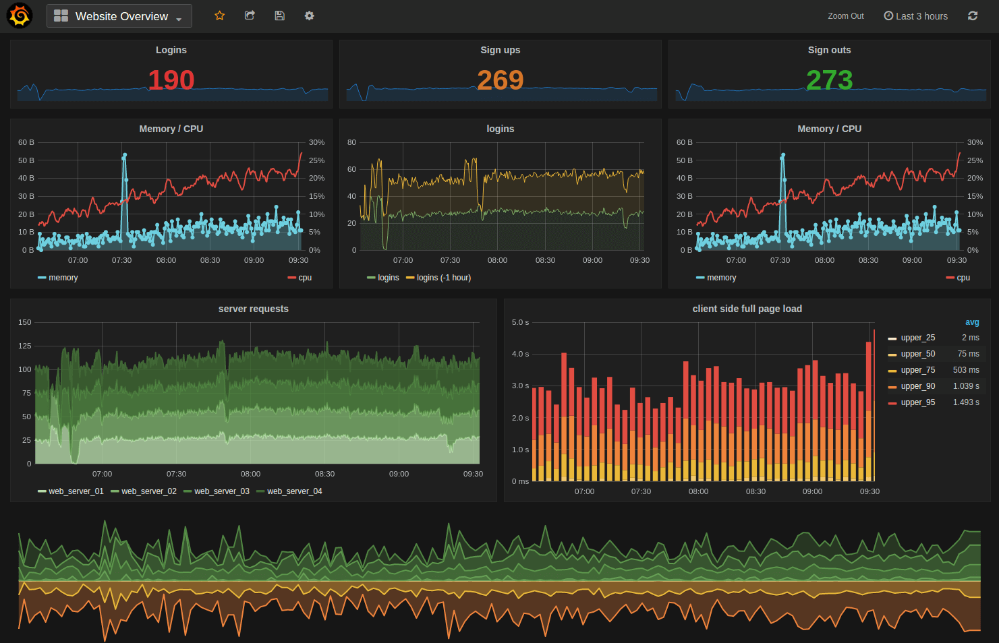
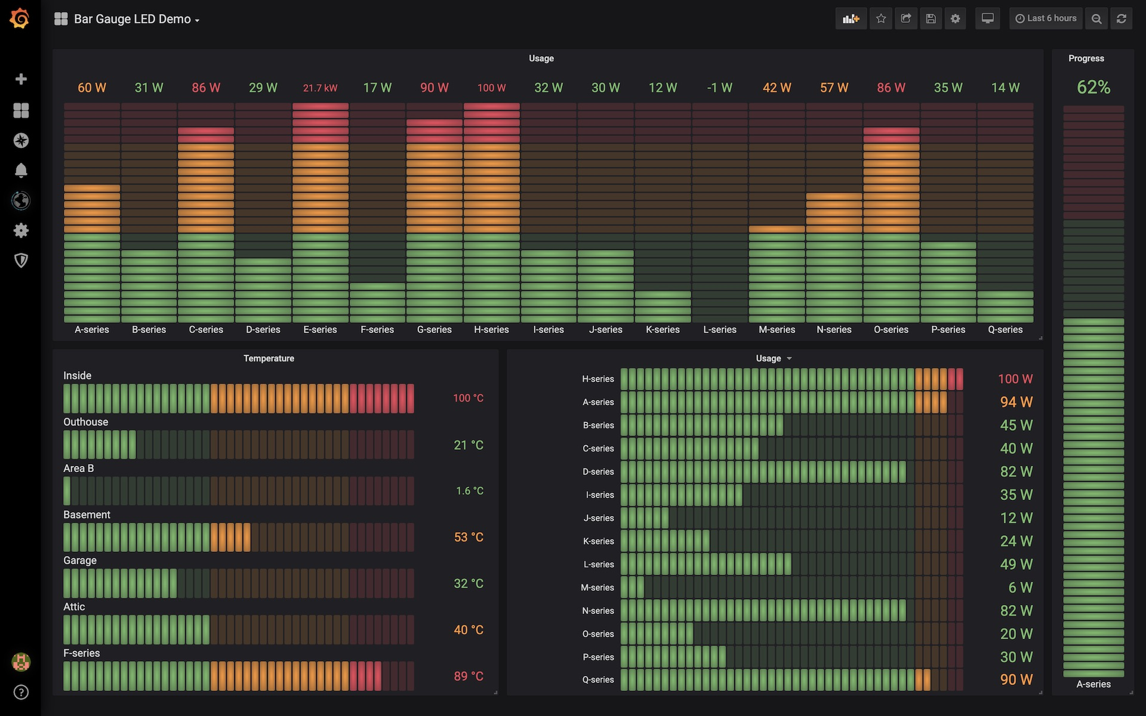
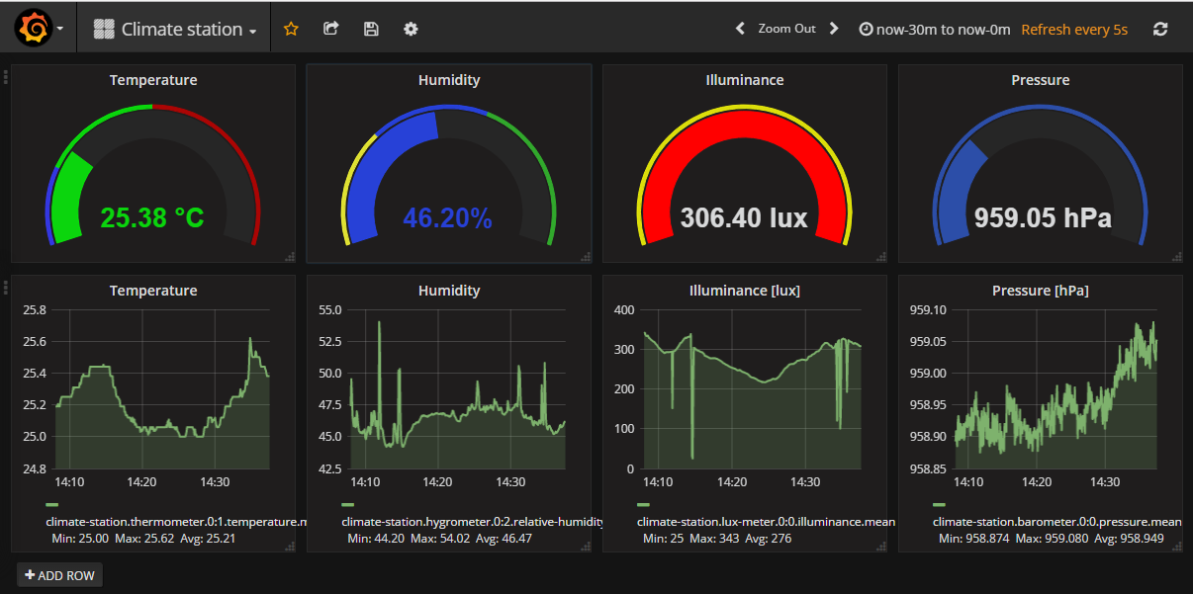

Slide 9
Importance of Grafana
With the help of dashboards, data is presented in an informative, efficient, and presentable manner.
Grafana makes the users know the data well.
The dashboards in Grafana can be shared with the team members.
Time series data and real-time data can be found fruitful with visualization if we are using Grafana.
The logs can be created so that data can be tracked easily if any backlogs happen.

Slide 10
ZEPHYR

Slide 11
Zephyr is a test Management tool used as a plugin with JIRA tool
JIRA is an Incident Management Tool used for Project Management, Bug Tracking, Issue Tracking and Workflow.
Zephyr was bought in as a plugin to support the test management like other tools such as QC (Quality Center) etc
Using Zephyr we can create test cases, track them and also manage similar to that of a defect life cycle.

Slide 12
Advantages
Better traceability with the linkage between stories, test cases and bugs in the test cycles.
Graphical representation of the results
Test cases can be exported to word, excel formats.
Test case review process possible through agile board.
Multiple test iterations with multiple cycles can be created.
Possible to create customized filters.

Slide 13
Limitations
Importing existing test cases from excel is not easy and one has to use some external addon for that.
Test result import not possible.
Not possible to export All the test cases and results in one file.
Test Case format is fixed and cannot be customized. Test cases have only 3 standard columns.
Reporting can be done for only one particular cycle of an iteration. A cumulative report cannot be generated for all the test cycles of the iteration.
For Automation Suite Integration, one to use Zephyr Enterprise Edition. Integration can be done with Selenium RC. Integration with Selenium Web Driver is not implemented.

Slide 14
REFERENCE
https://site.mockito.org
https://grafana.com
https://www.testmanagement.com/zephyr

Slide 15
THANK YOU!
15

